Slide 1
English
Unit 2 – Sport
WALT:
6Sc.03 Ask questions to find out information and to clarify meaning on a range of topics and respond accordingly.

Slide 2



WALT: Ask questions to find out information and to clarify meaning on a range of topics and respond accordingly.
I can say what my favourite sport is.
I can say what the best thing about my favourite sport is and what equipment is needed.
I can give extra detail to my answers

Slide 3
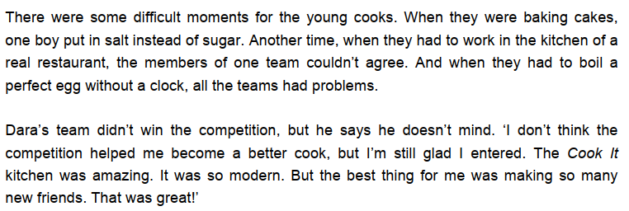
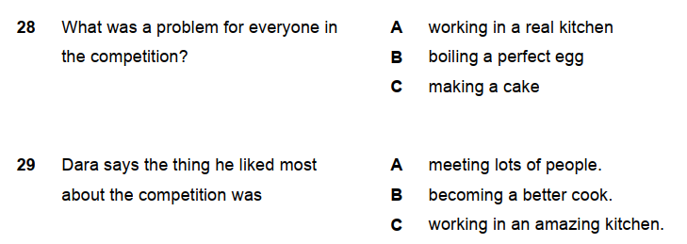
Retrieval Practice
WALT: Ask questions to find out information and to clarify meaning on a range of topics and respond accordingly.

Slide 4
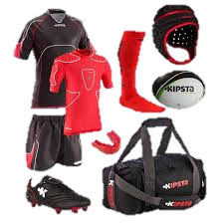
Starter – Guess the sport from the equipment.
WALT: Ask questions to find out information and to clarify meaning on a range of topics and respond accordingly.
Rugby

Slide 5
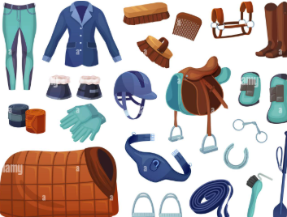
Starter – Guess the sport from the equipment.
WALT: Ask questions to find out information and to clarify meaning on a range of topics and respond accordingly.
Horse Riding

Slide 6
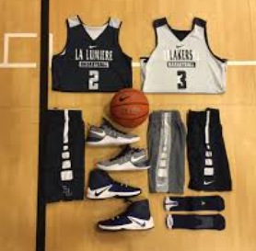
Starter – Guess the sport from the equipment.
WALT: Ask questions to find out information and to clarify meaning on a range of topics and respond accordingly.
Basketball

Slide 7
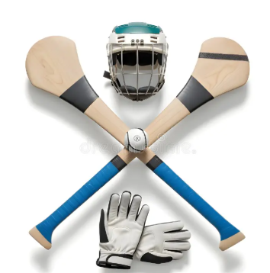
Starter – Guess the sport from the equipment.
WALT: Ask questions to find out information and to clarify meaning on a range of topics and respond accordingly.
Hurling

Slide 8
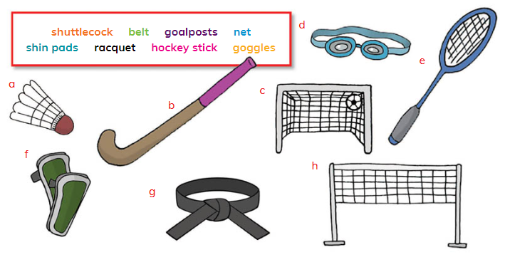

WALT: Ask questions to find out information and to clarify meaning on a range of topics and respond accordingly.
What equipment do the students in the audio recording need to play their sports?

Slide 9
Talk to your partner ask and answer these three questions.
WALT: Ask questions to find out information and to clarify meaning on a range of topics and respond accordingly.
What is your favourite sport?
What is the best thing about your favourite sport?
What equipment do you need for your favourite sport?
Give more detail in your answers. Why is X the best thing? Why do you need this equipment? Is it expensive / comfortable / necessary etc.

Slide 10
WALT: Ask questions to find out information and to clarify meaning on a range of topics and respond accordingly.
I can say what my favourite sport is.
I can say what the best thing about my favourite sport is and what equipment is needed.
I can give extra detail to my answers

Slide 11
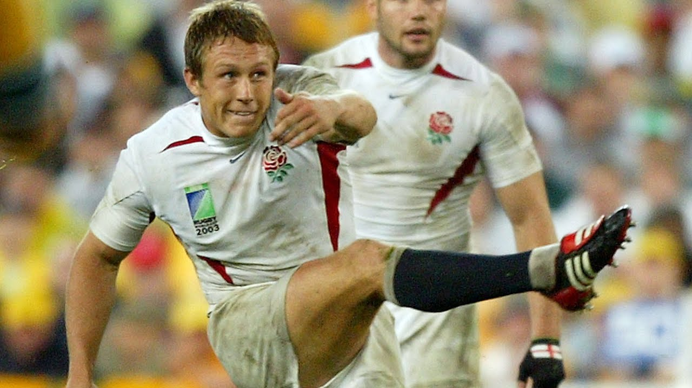
Plenary – What sport do you think is being commentated on here?
WALT: Ask questions to find out information and to clarify meaning on a range of topics and respond accordingly.
Rugby

Slide 12
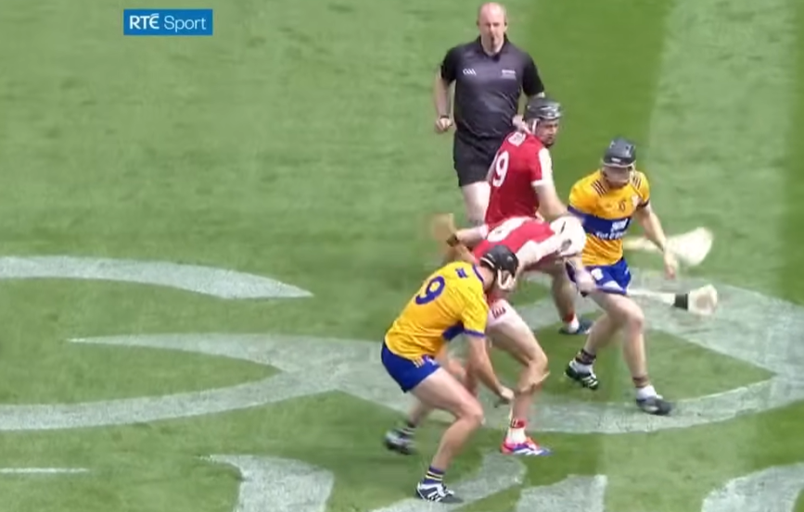
WALT: Ask questions to find out information and to clarify meaning on a range of topics and respond accordingly.
https://www.youtube.com/watch?v=uMsEdM3wsP8

